Slide 1
Performance Calculation and Weight Estimation
Presented by Ritwik

Slide 2

Validation of BEMT performance
We use Harrington rotor experimental results to validate our BEMT performance (in hover mode)
Although that data is for co-axial rotors, we will only take single rotor results
Harrington has results for σ= 0.076 and Tip speed ≈ 392 ft/s so we run our code these values to plot the variation of $C_{Q}$ vs $C_{T}$

Slide 3
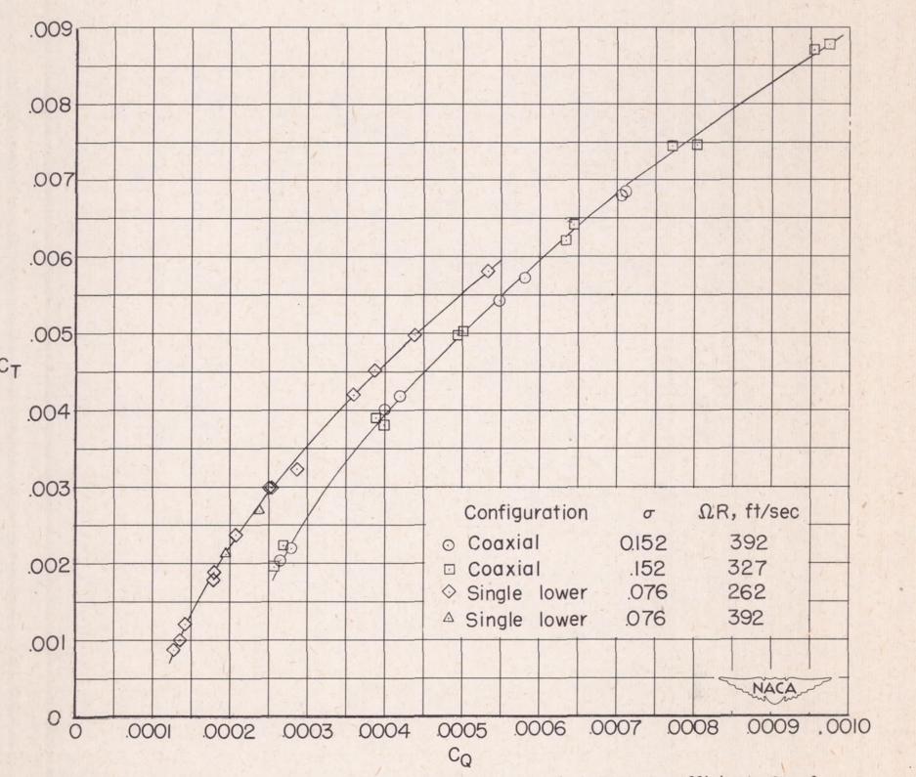
Experimental Data
Chord with no Taper
0.2 blade cutoff

Slide 4
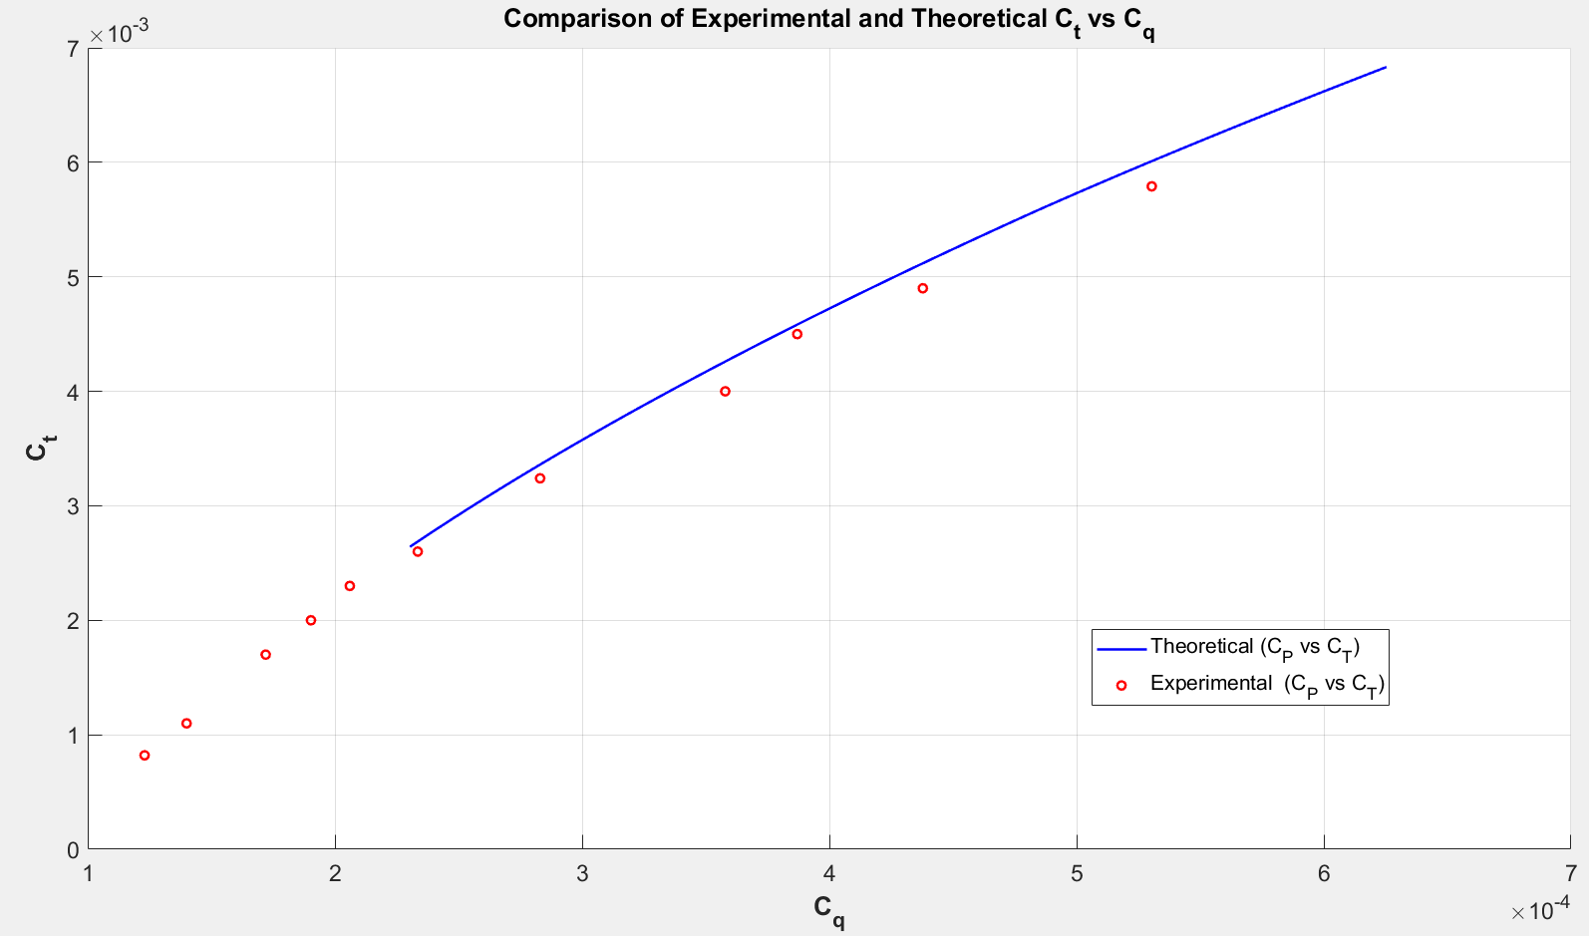

Slide 5
Parameter | Theoretical Value | Experimental Value
Solidity | 0.076 | 0.076
Tip Speed (ft/sec) | 392 | 391.9
Airfoil | NACA symmetric | NACA 0012
Radius (inch) | 150 | 150
Chord (inch) | 18 | 19.1

Slide 6
Power System Sizing
Hydrogen fuel considered with Specific Energy Density 0.8-1 KW Hr/Kg
Full system mass to consider Power density of 0.1-0.15 KW /Kg
Initially system weight will be calculated for an estimate T9 = 30 mins
Then after getting an estimate system weight from IIT Gn we will maximise T9

Slide 7
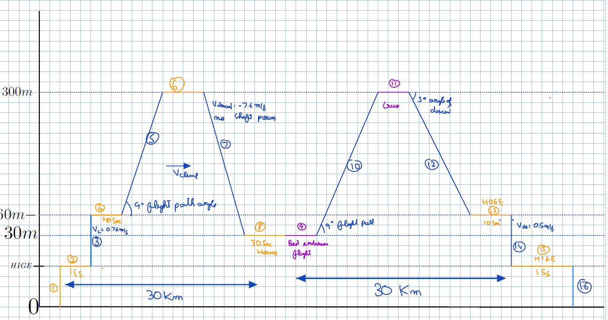
Mission Segment for energy calculations

Slide 8
PARAM | VALUE | PARAM | VALUE
Number of Blades | 3 | Total Hover Power Watt | ~200 KW
NumberOfRotors | 8 | GrossWeight | < 700 Kg
Radius | 0.85:0.05:1.2 m | Total Energy | ~50 KW Hr
RPM | 2000:500:8000 | Twist | -16 degrees
Descent Speed | -0.5m/s | CollectiveInDegrees | ~18-22
ClimbSpeed | 0.76 m/s | PowerLoading | 0.029
CruiseVelocity | 40 m/s | DiskLoading | <140 N/m^2
T9 time to be maximised for loiter | 0.5 Hours | AspectRatio | ~10-12
BEMT PARAMS

Slide 9
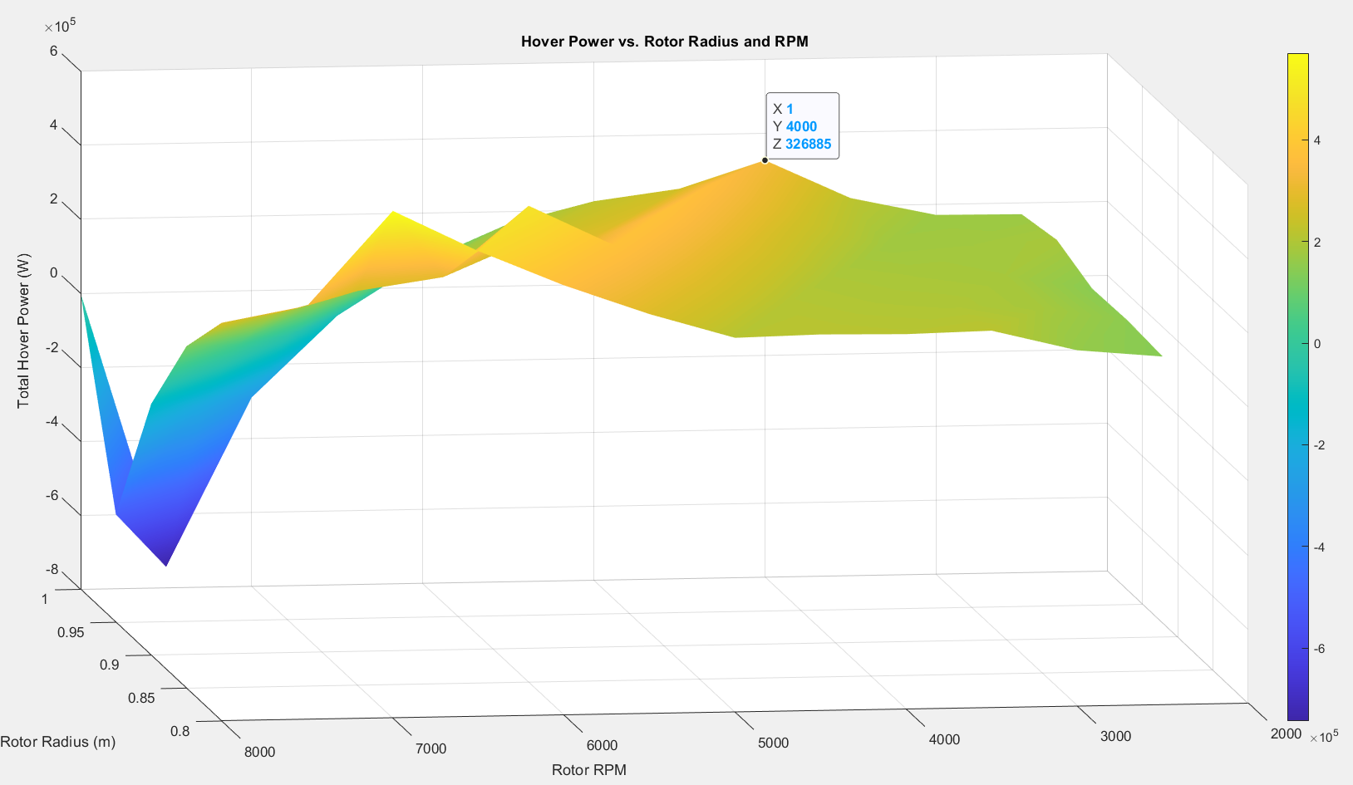

Slide 10
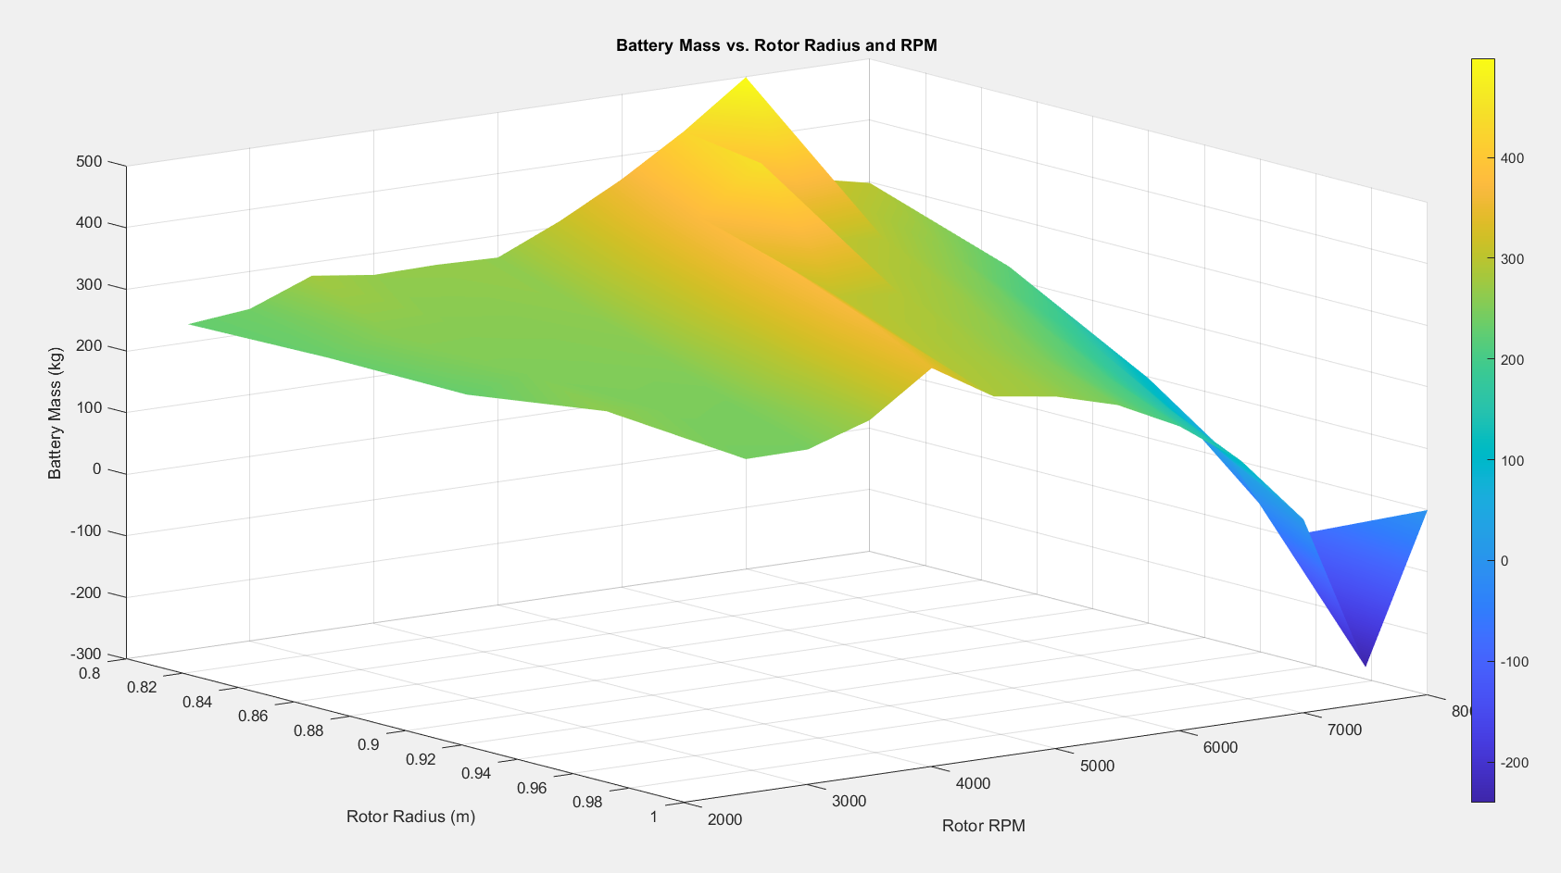

Slide 11
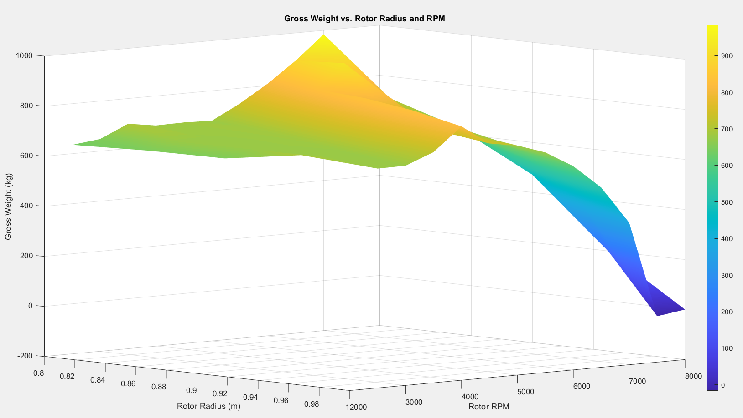

Slide 12
